Slide 1
Module 3 - In-Memory Data Store Services

Slide 2

Objectives
Understand of Redis and Memcached In-memory services
Learn Redis Data Structure - List, Set, hash
Redis command line interface
Learn PubSub and Bonus Features

Slide 3
Amazon ElastiCache
Amazon ElastiCache offers fully managed Redis and Memcached. Seamlessly deploy, run, and scale popular open source compatible in-memory data stores. Build data-intensive apps or improve the performance of your existing apps by retrieving data from high throughput and low latency in-memory data stores. Amazon ElastiCache is a popular choice for Gaming, Ad-Tech, Financial Services, Healthcare, and IoT apps.

Slide 4


Amazon ElastiCache Engines
Amazon ElastiCache for Redis:
Manage and analyze fast moving data with a versatile in-memory data store.
Amazon ElastiCache for Memcached: Build a scalable Caching Tier for data-intensive apps.

Slide 5
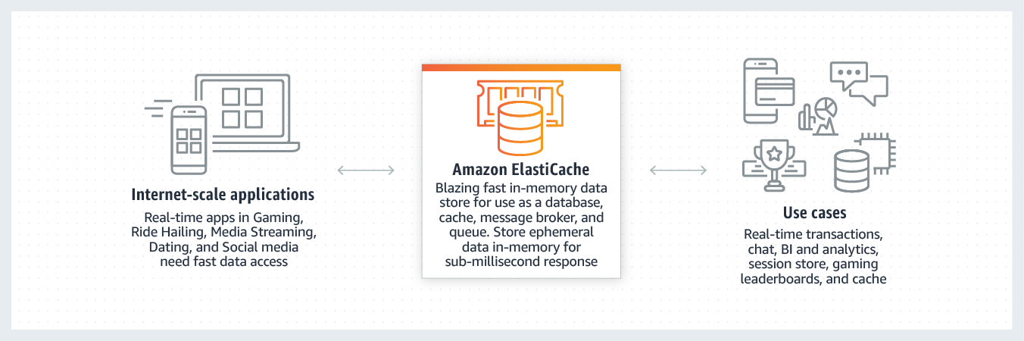
Working of Elasticache

Slide 6
Benefits of using Elasticache
EXTREME PERFORMANCE
FULLY MANAGED
SCALABLE

Slide 7
Amazon ElastiCache for Redis
Amazon ElastiCache for Redis is a blazing fast in-memory data store that provides sub-millisecond latency to power internet-scale real-time applications.
1
Built on open-source Redis and compatible with the Redis APIs, ElastiCache for Redis works with your Redis clients and uses the open Redis data format to store your data.
2
Your self-managed Redis applications can work seamlessly with ElastiCache for Redis without any code changes.
3

Slide 8
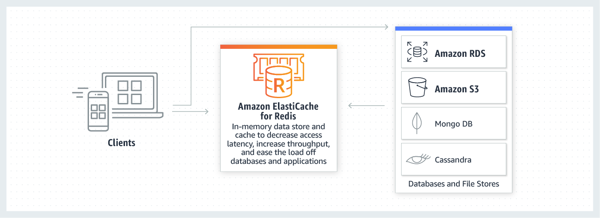
Usecase for Caching using Redis

Slide 9
Demo – Creating Elasticache for Redis

Slide 10
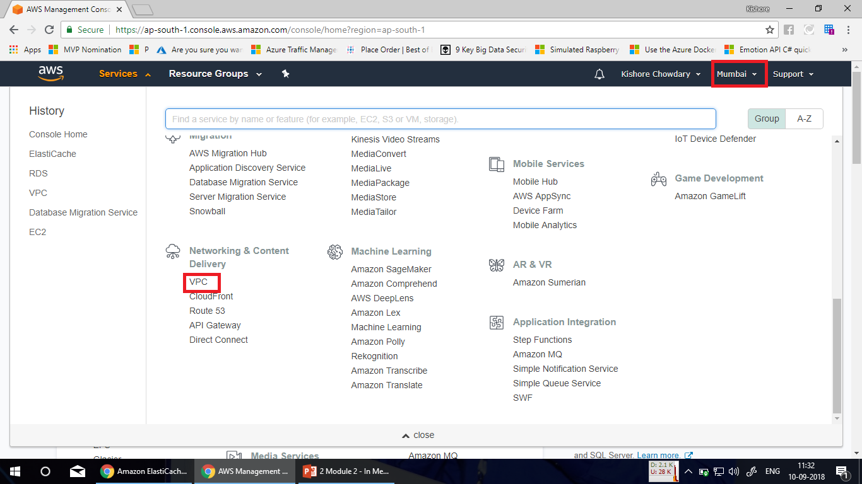

Slide 11
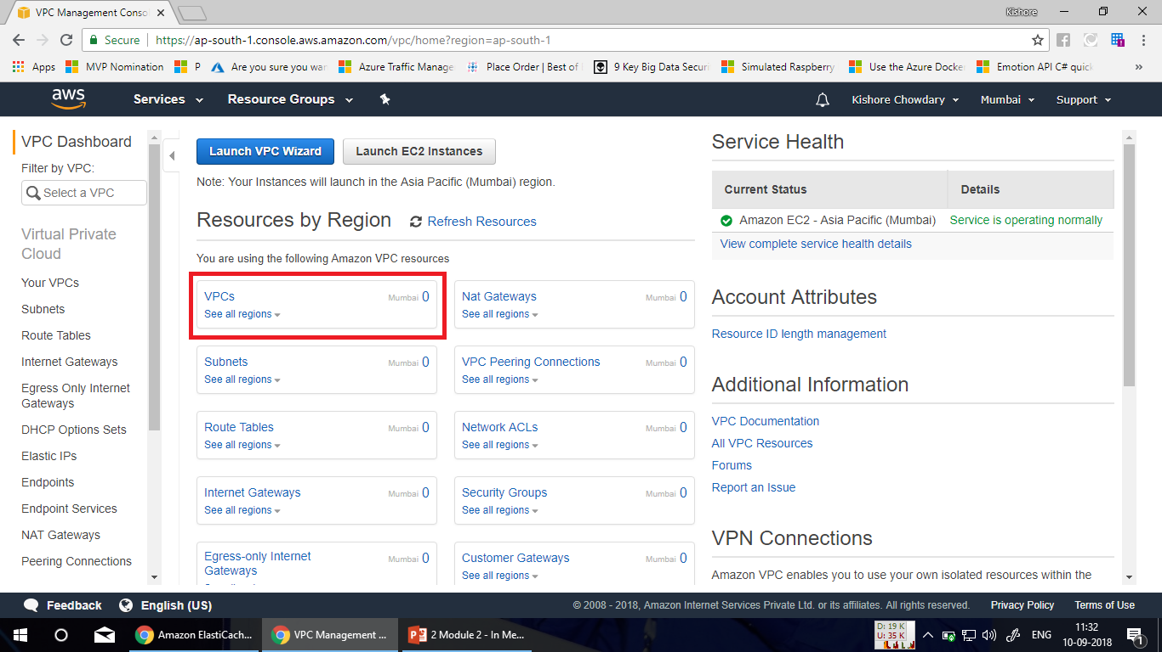

Slide 12
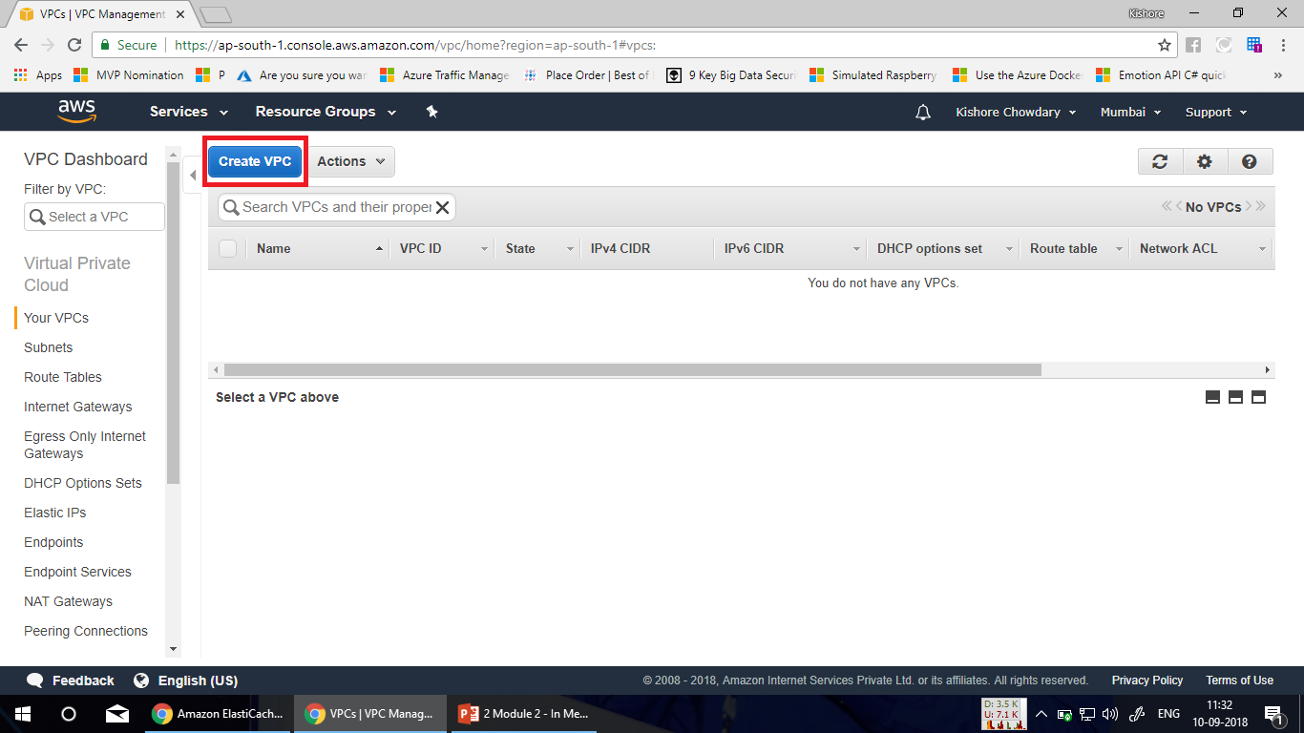

Slide 13
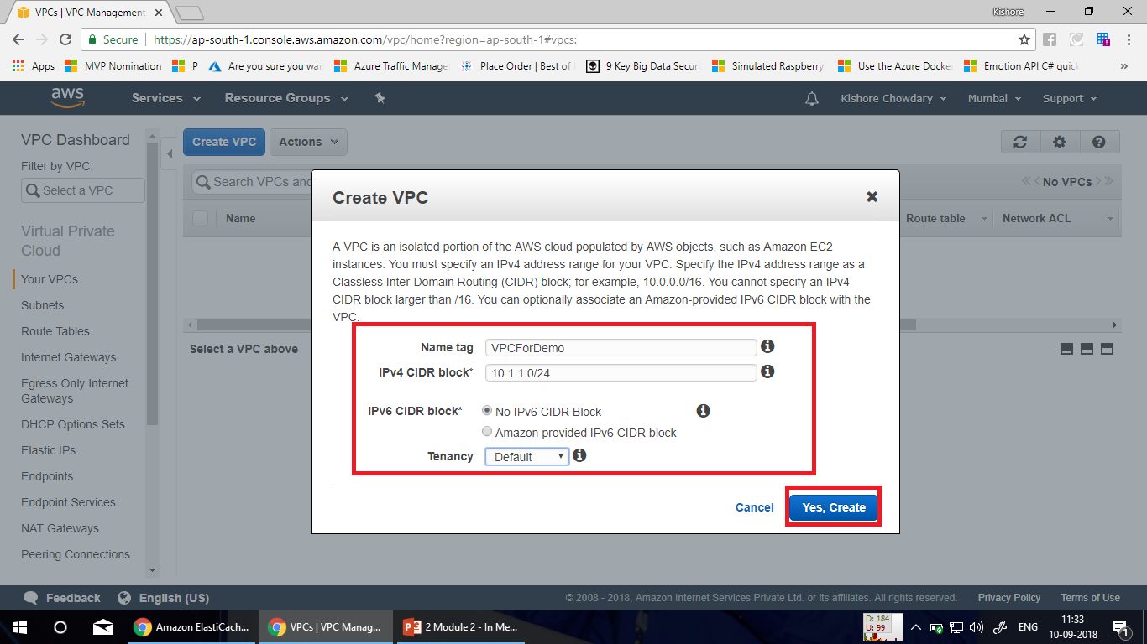

Slide 14
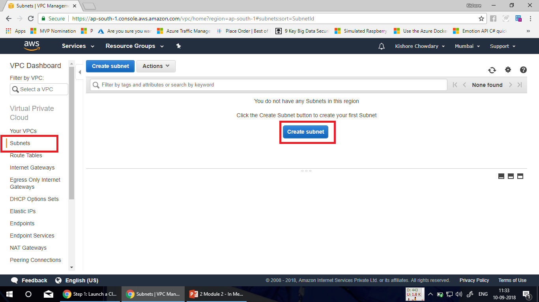

Slide 15
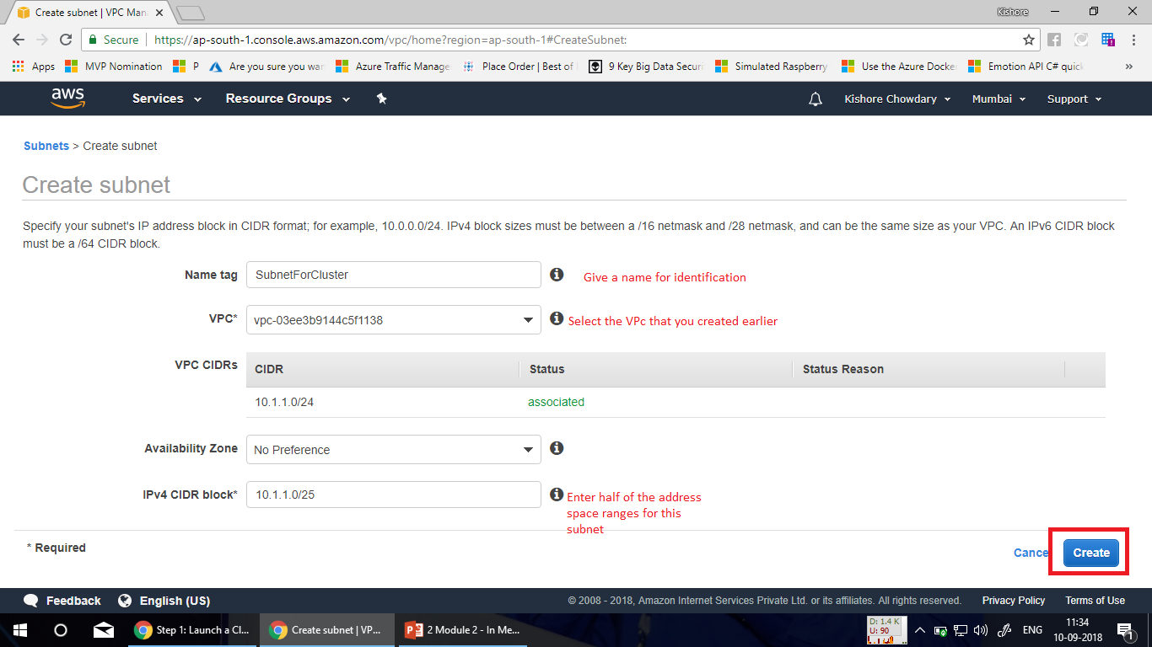

Slide 16
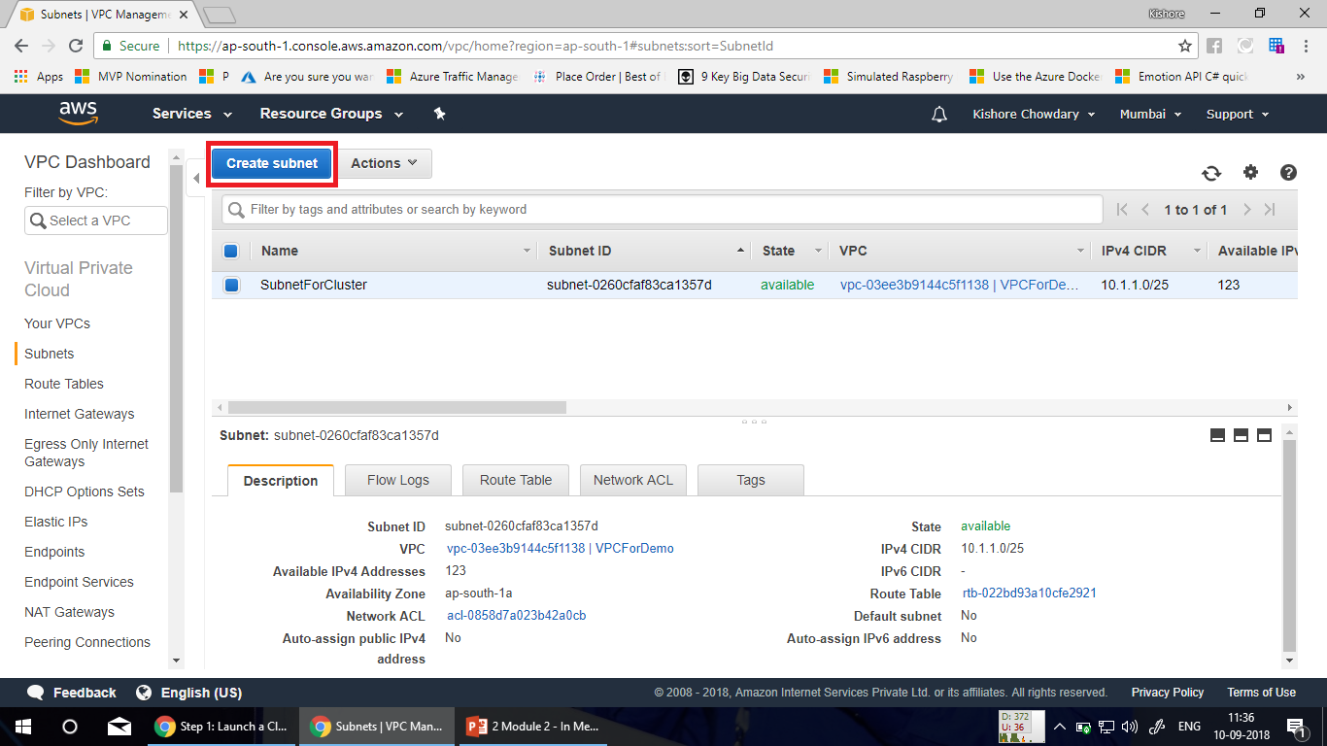

Slide 17
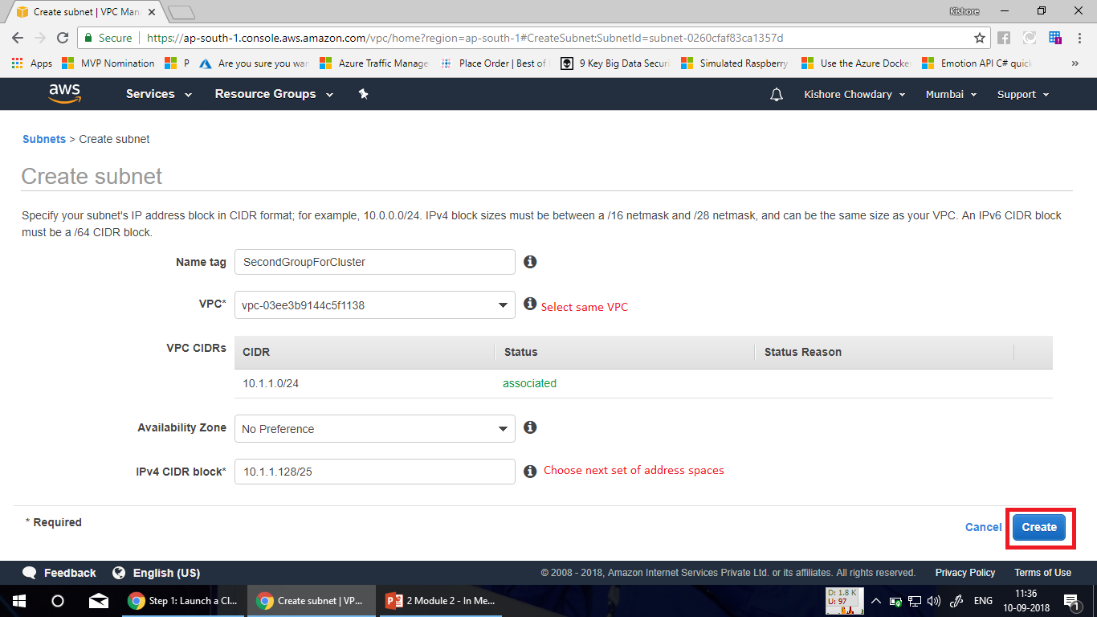

Slide 18
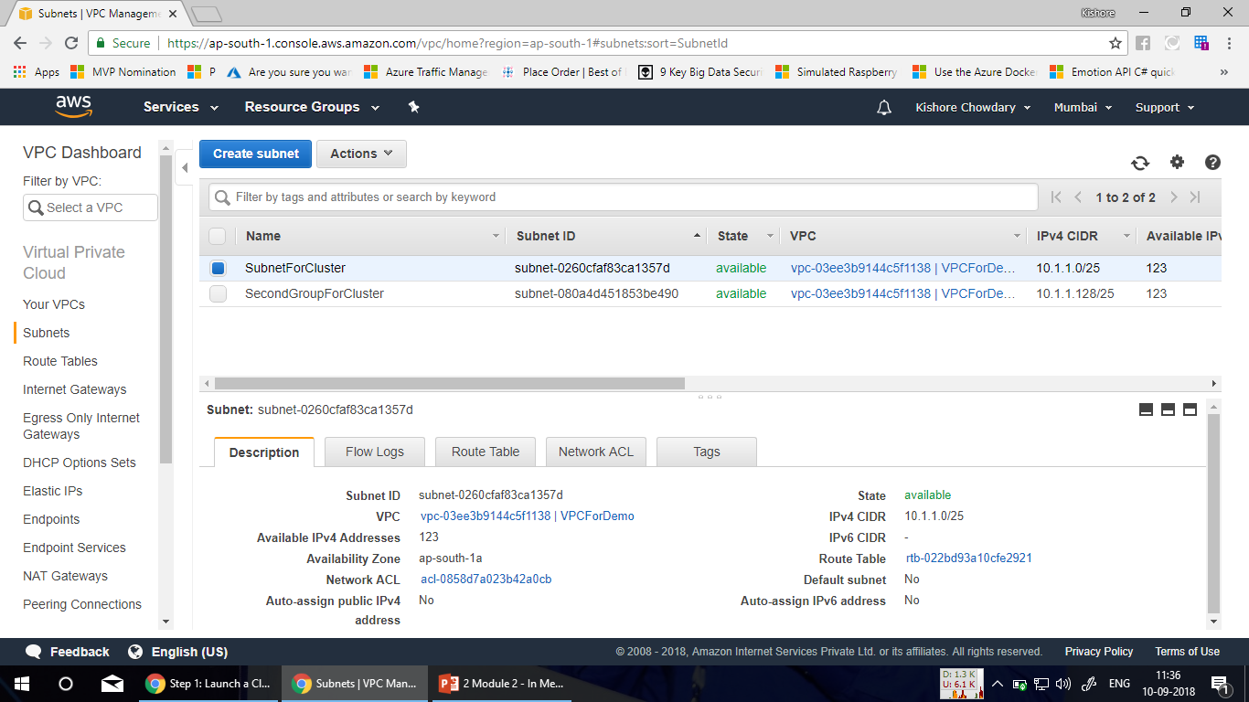

Slide 19
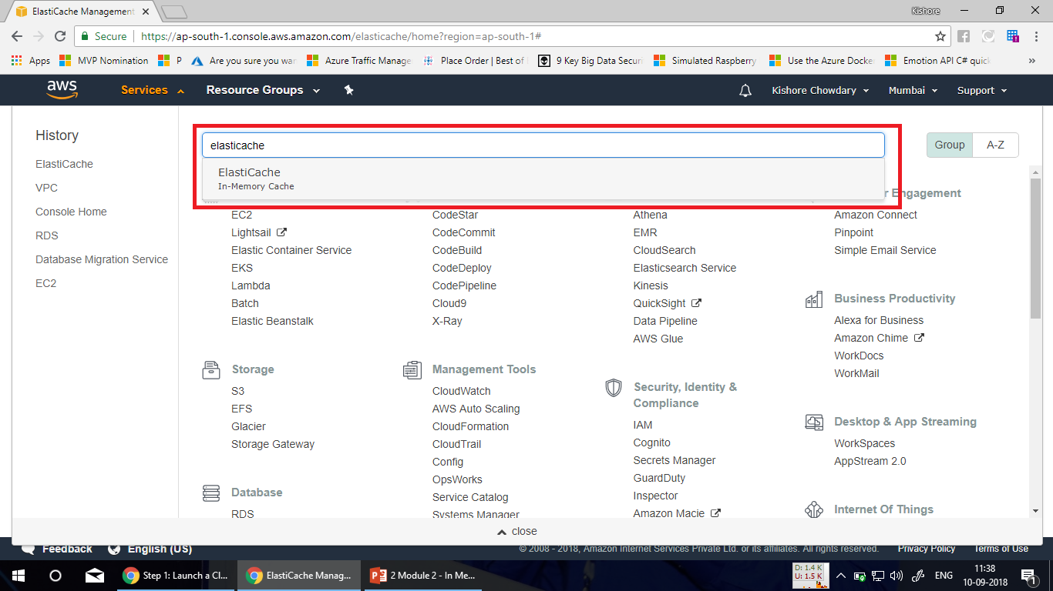

Slide 20
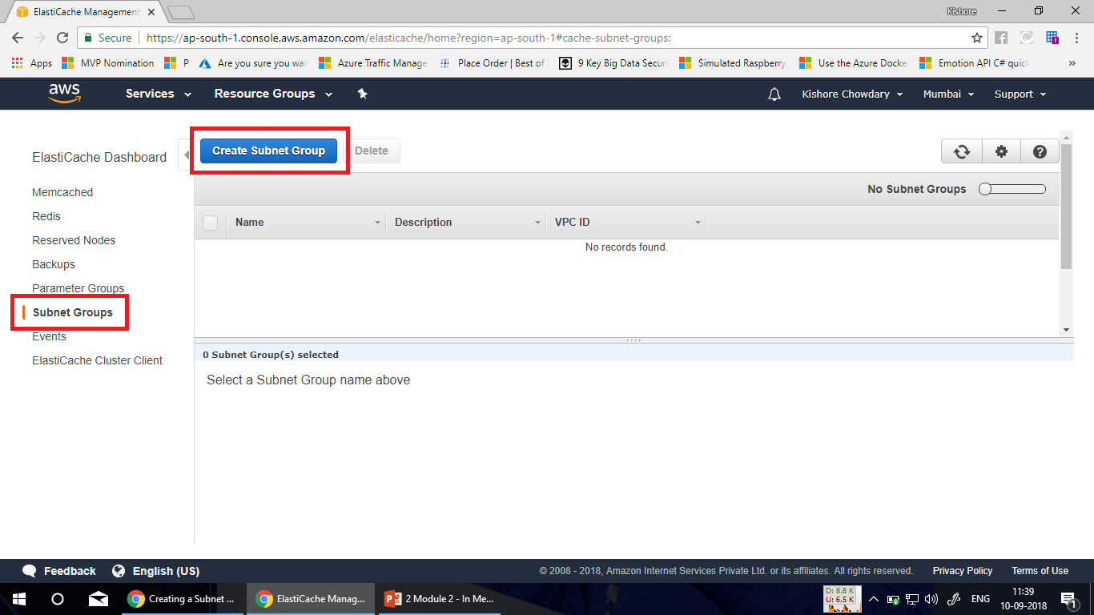

Slide 21
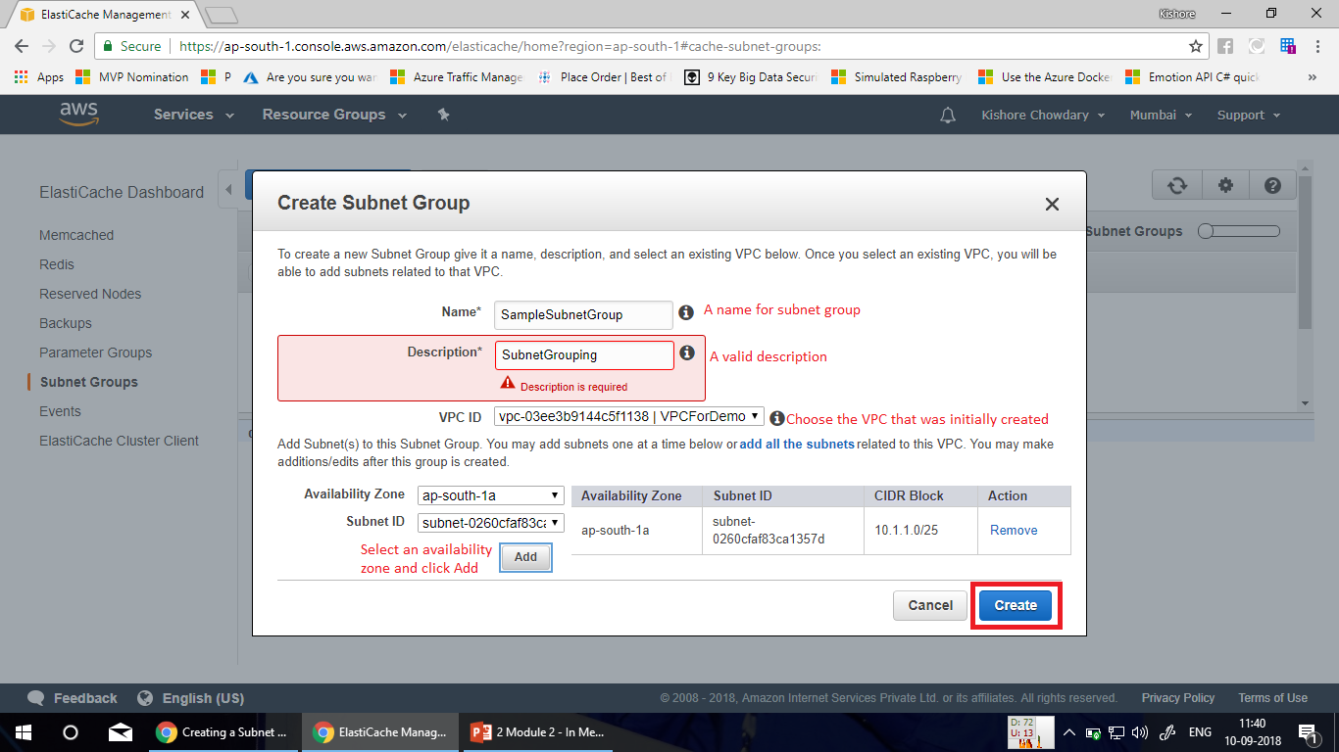

Slide 22
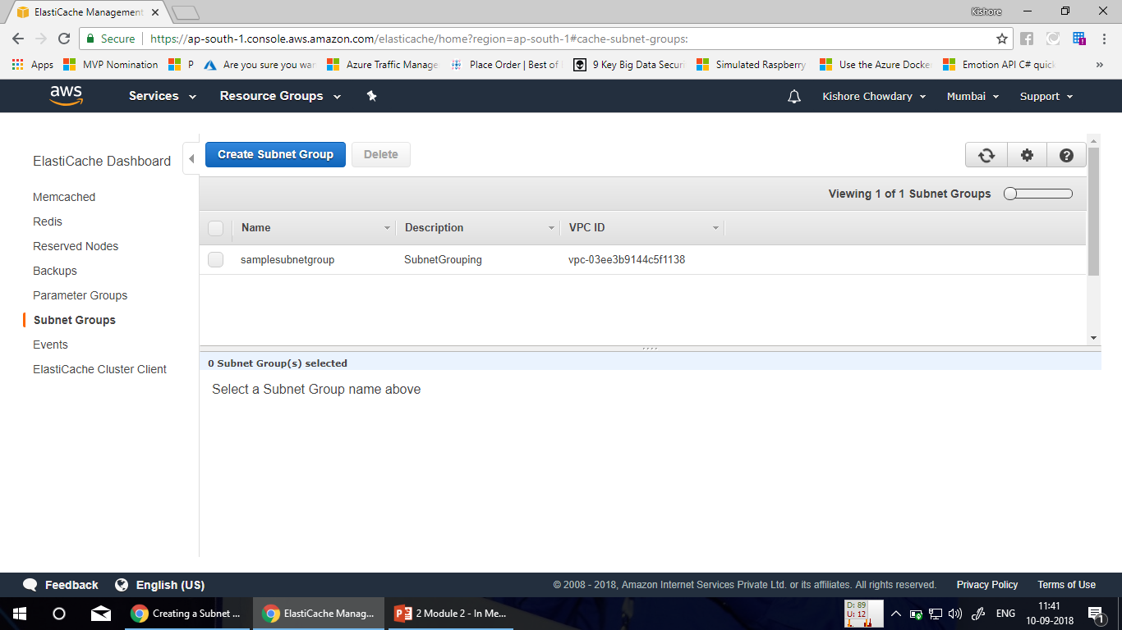

Slide 23
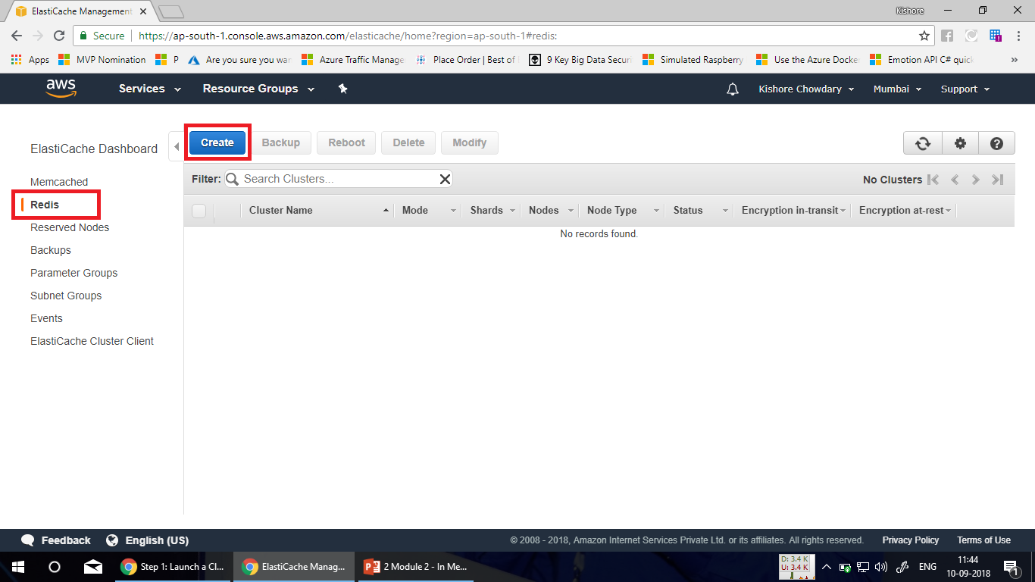

Slide 24
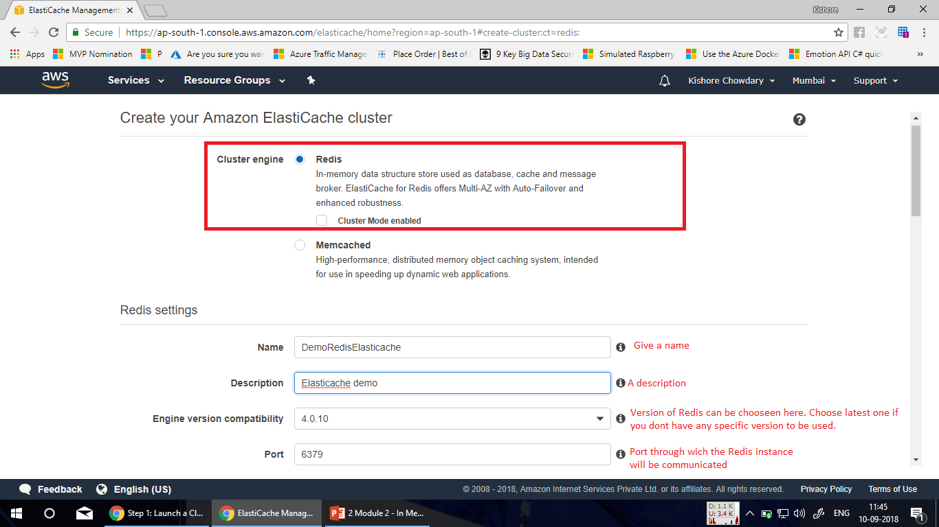

Slide 25
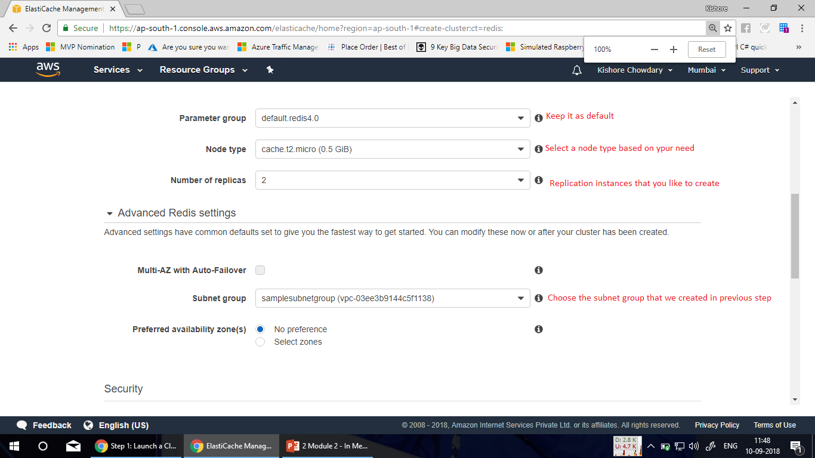

Slide 26
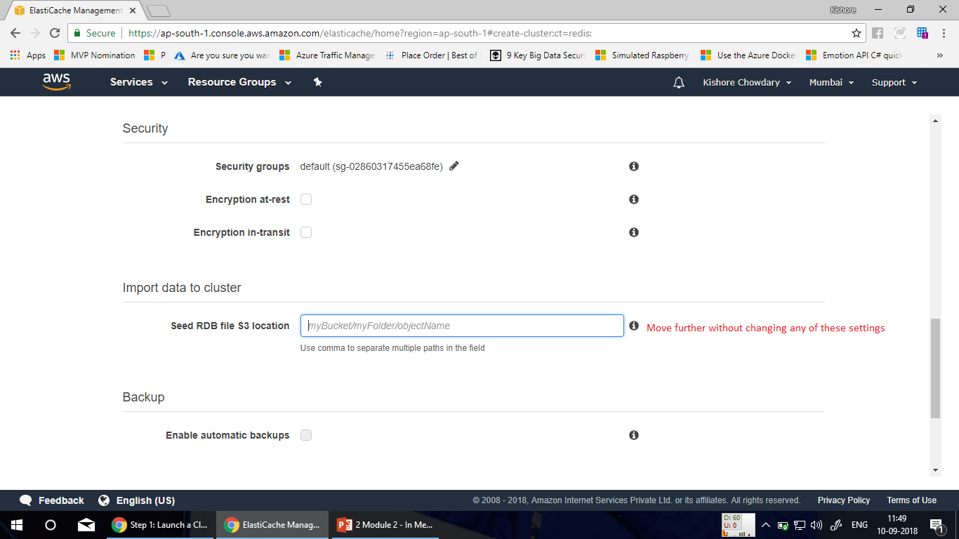

Slide 27
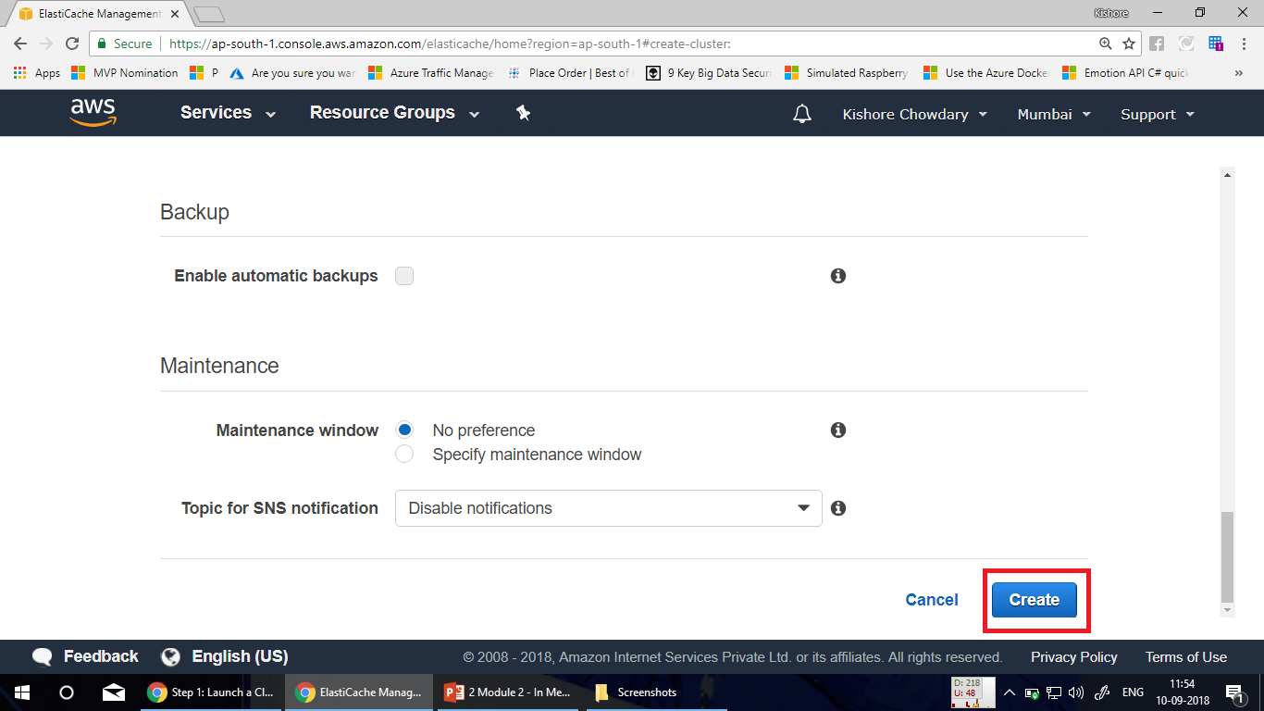

Slide 28
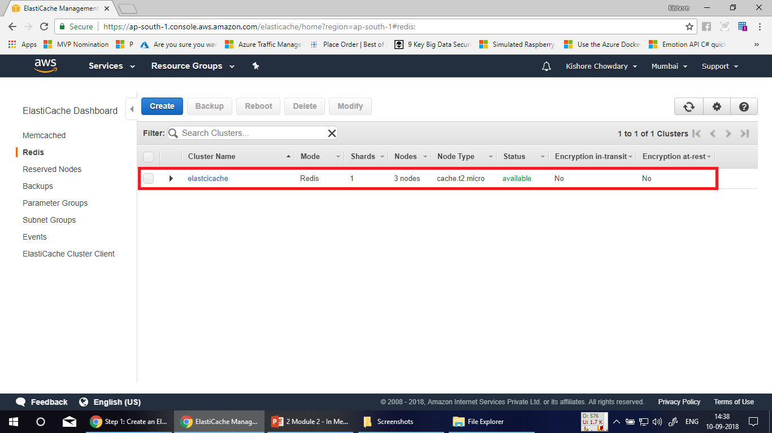

Slide 29
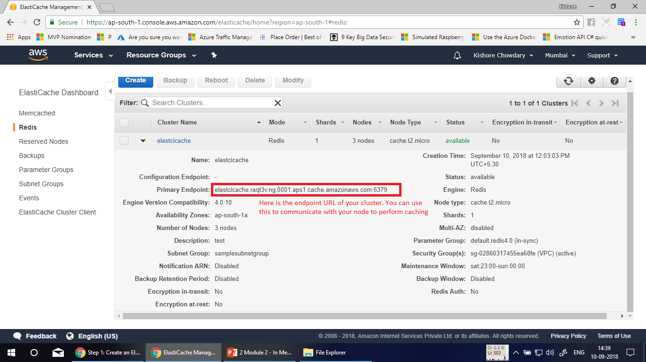

Slide 30
Amazon ElastiCache for Memcached
Amazon ElastiCache for Memcached is a Memcached-compatible in-memory key-value store service that can be used as a cache or a data store.
It delivers the performance, ease-of-use, and simplicity of Memcached.
ElastiCache for Memcached is fully managed, scalable, and secure - making it an ideal candidate for use cases where frequently accessed data must be in-memory.
It is a popular choice for use cases such as Web, Mobile Apps, Gaming, Ad-Tech, and E-Commerce.

Slide 31
Use Case for Memcached
Amazon ElastiCache for Memcached is a great choice for implementing an in-memory cache to decrease access latency, increase throughput, and ease the load off your relational or NoSQL database. Amazon ElastiCache can serve frequently requested items at sub-millisecond response times , and enables you to easily scale for higher loads without growing the costlier backend database layer. Database query results caching, persistent session caching, and full-page caching are all popular examples of caching with ElastiCache for Memcached.

Slide 32
Demo – Creating Elasticache for Memcached

Slide 33
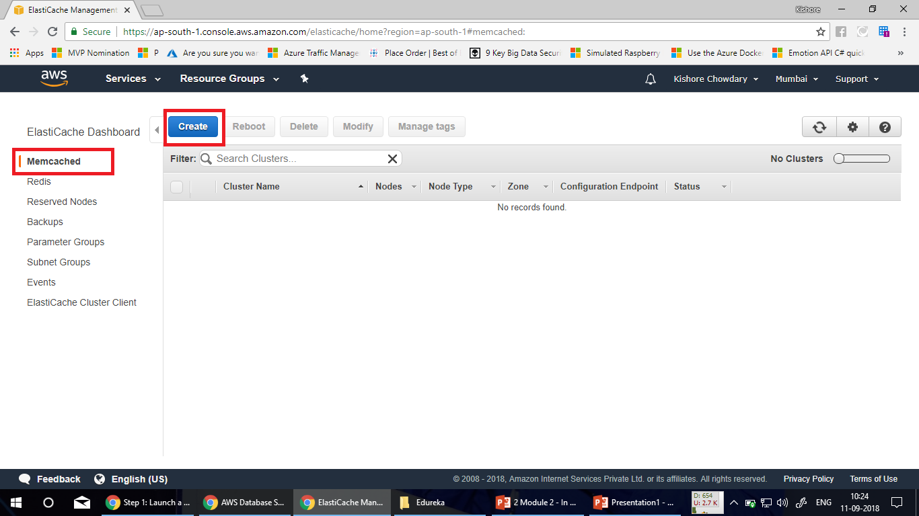

Slide 34
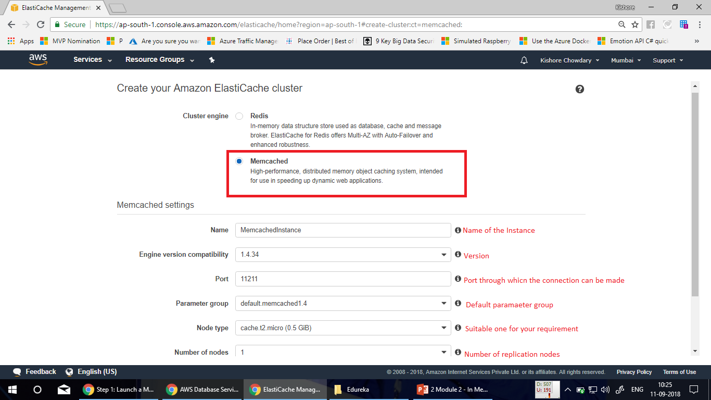

Slide 35
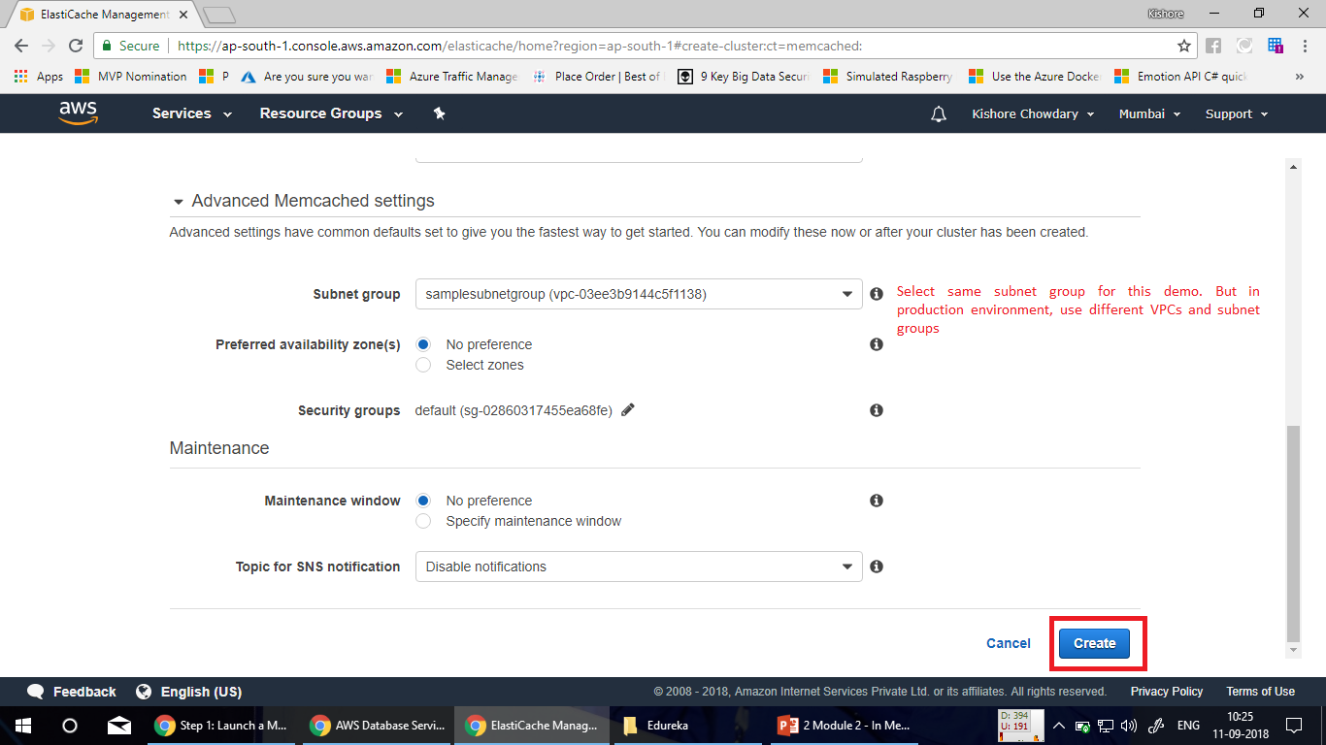

Slide 36
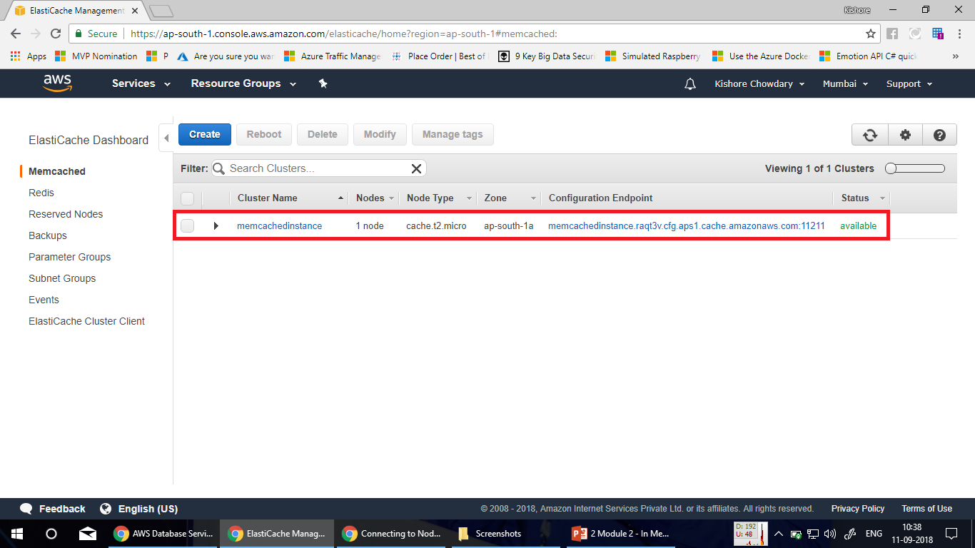

Slide 37
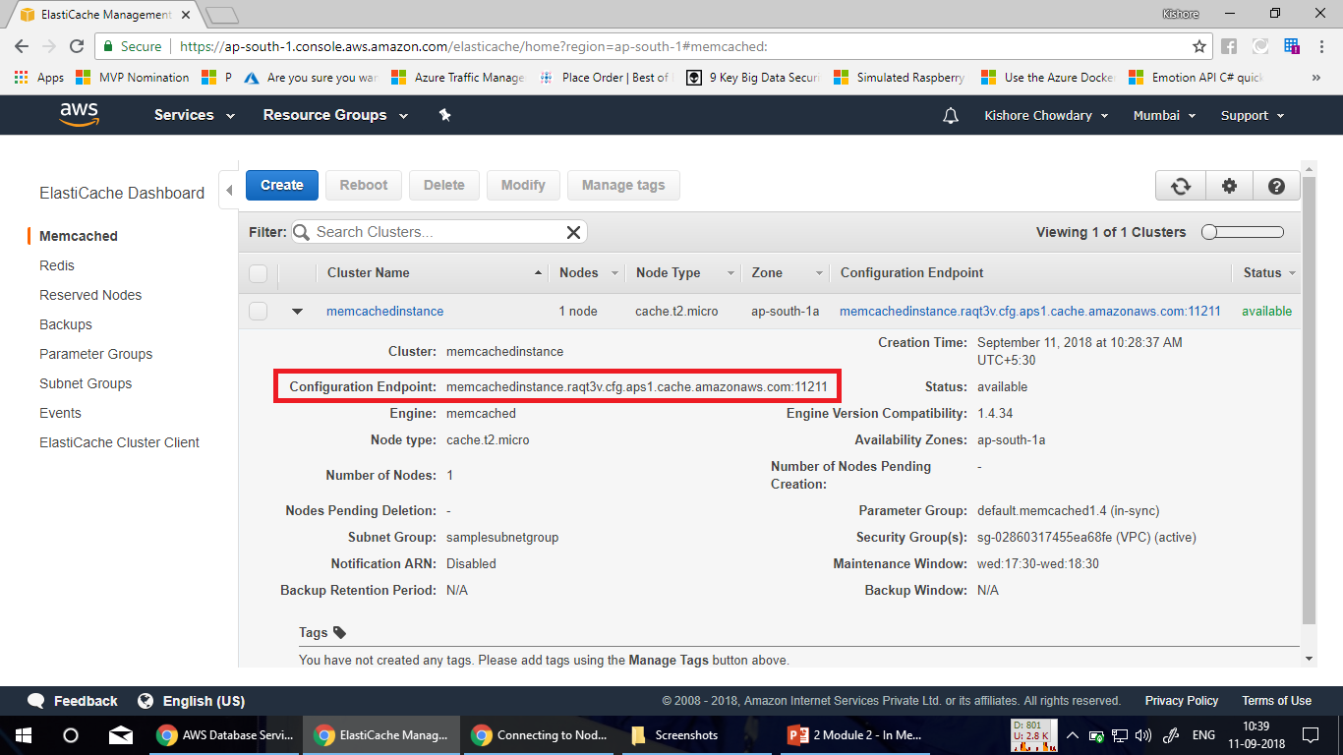

Slide 38
Thus we have done with the creation of elasticache for Redis and ealsticache for Memcached. You can now use this for making connection with your cluster by utilizing its endpoint URL and opening the access ports for its required resources.
Refer the URL for connecting Redis with services
https://aws.amazon.com/blogs/database/automating-sql-caching-for-amazon-elasticache-and-amazon-rds/
https://aws.amazon.com/elasticache/redis/
Refer here for connecting to Memcached
https://docs.aws.amazon.com/AmazonElastiCache/latest/mem-ug/nodes-connecting.html

Slide 39

Redis Data types
Redis supports few data types as given below:
Strings
Lists
Sets
Hashes

Slide 40

Strings
Strings are the most basic kind of Redis value. Redis Strings are binary safe, this means that a Redis string can contain any kind of data, for instance a JPEG image or a serialized Ruby object.
A String value can be at max 512 Megabytes in length.
You can do a number of interesting things using strings in Redis, for instance you can:
Use Strings as atomic counters using commands in the INCR family: INCR, DECR, INCRBY.
Append to strings with the APPEND command.
Use Strings as a random access vectors with GETRANGE and SETRANGE.
Encode a lot of data in little space, or create a Redis backed Bloom Filter using GETBIT and SETBIT.
Check all the available string commands for more information, or read the introduction to Redis data types.

Slide 41
Lists
Redis Lists are simply lists of strings, sorted by insertion order. It is possible to add elements to a Redis List pushing new elements on the head (on the left) or on the tail (on the right) of the list.
The LPUSH command inserts a new element on the head, while RPUSH inserts a new element on the tail. A new list is created when one of this operations is performed against an empty key. Similarly the key is removed from the key space if a list operation will empty the list. These are very handy semantics since all the list commands will behave exactly like they were called with an empty list if called with a non-existing key as argument.

Slide 42
Example of list operations and resulting lists
LPUSH mylist a # now the list is "a"
LPUSH mylist b # now the list is "b","a"
RPUSH mylist c # now the list is "b","a","c" (RPUSH was used this time)

Slide 43
Sets
Redis Sets are an unordered collection of Strings. It is possible to add, remove, and test for existence of members in O(1) (constant time regardless of the number of elements contained inside the Set).
Redis Sets have the desirable property of not allowing repeated members. Adding the same element multiple times will result in a set having a single copy of this element. Practically speaking this means that adding a member does not require a check if exists then add operation.

Slide 44
Hashes
Redis Hashes are maps between string fields and string values, so they are the perfect data type to represent objects
(e.g. A User with a number of fields like name, surname, age, and so forth):
@cli
HMSET user:1000 username antirez password P1pp0 age 34
HGETALL user:1000
HSET user:1000
password 12345 HGETALL user:1000

Slide 45
Redis CLI
Redis-cli is the Redis command line interface, a simple program that allows to send commands to Redis, and read the replies sent by the server, directly from the terminal.
It has two main modes:
An interactive mode where there is a REPL (Read Eval Print Loop) where the user types commands and get replies.
Another mode where the command is sent as arguments of redis-cli, executed, and printed on the standard output.

Slide 46
Command line usage
To just run a command and have its reply printed on the standard output is as simple as typing the command to execute as separated arguments of redis-cli:
$ redis-cli incr mycounter (integer) 7
The reply of the command is "7". Since Redis replies are typed (they can be strings, arrays, integers, NULL, errors and so forth), you see the type of the reply between brackets. However that would be not exactly a great idea when the output of redis-cli must be used as input of another command, or when we want to redirect it into a file.

Slide 47
Command Line Usage
Actually redis-cli only shows additional information which improves readability for humans when it detects the standard output is a tty (a terminal basically). Otherwise it will auto-enable the raw output mode, like in the following example:
$ redis-cli incr mycounter > /tmp/output.txt
$ cat /tmp/output.txt
8

Slide 48
Command Line Usage
This time (integer) was omitted from the output since the CLI detected the output was no longer written to the terminal. You can force raw output even on the terminal with the --raw option:
$ redis-cli --raw incr mycounter
9

Slide 49
Host, port, password and database
By default redis-cli connects to the server at 127.0.0.1 port 6379. As you can guess, you can easily change this using command line options. To specify a different host name or an IP address, use -h. In order to set a different port, use -p.
$ redis-cli -h redis15.localnet.org -p 6390 ping PONG

Slide 50
Host, port, password and database
If your instance is password protected, the -a <password> option will preform authentication saving the need of explicitly using the AUTH command:
$ redis-cli -a myUnguessablePazzzzzword123 ping PONG

Slide 51
Host, port, password and database
Finally, it's possible to send a command that operates a on a database number other than the default number zero by using the -n <dbnum> option:
$ redis-cli flushall
OK
$ redis-cli -n 1 incr a
(integer) 1
$ redis-cli -n 1 incr a
(integer) 2
$ redis-cli -n 2 incr a
(integer) 1

Slide 52

Host, port, password and database
Finally, it's possible to send a command that operates a on a database number other than the default number zero by using the -n <dbnum> option:
$ redis-cli flushall
OK
$ redis-cli -n 1 incr a
(integer) 1
$ redis-cli -n 1 incr a
(integer) 2
$ redis-cli -n 2 incr a
(integer) 1
Some or all of this information can also be provided by using the -u <uri> option and a valid URI:
$ redis-cli -u redis://p%40ssw0rd@redis-16379.hosted.com:16379/0 ping PONG

Slide 53
Interactive mode
So far we explored how to use the Redis CLI as a command line program. This is very useful for scripts and certain types of testing, however most people will spend the majority of time in redis-cli using its interactive mode.
In interactive mode the user types Redis commands at the prompt. The command is sent to the server, processed, and the reply is parsed back and rendered into a simpler form to read.
Nothing special is needed for running the CLI in interactive mode - just lunch it without any arguments and you are in:
$ redis-cli 127.0.0.1:6379> ping PONG

Slide 54
Interactive mode
The string 127.0.0.1:6379> is the prompt. It reminds you that you are connected to a given Redis instance.
The prompt changes as the server you are connected to changes, or when you are operating on a database different than the database number zero:
127.0.0.1:6379> select 2
OK
127.0.0.1:6379[2]> dbsize
(integer) 1
127.0.0.1:6379[2]> select 0
OK
127.0.0.1:6379> dbsize
(integer) 503

Slide 55

For more Redis CLI commands
Refer here for more CLI commands.
https://redis.io/topics/rediscli

Slide 56
Pub/Sub
SUBSCRIBE, UNSUBSCRIBE and PUBLISH implement the Publish/Subscribe messaging paradigm where (citing Wikipedia) senders (publishers) are not programmed to send their messages to specific receivers (subscribers). Rather, published messages are characterized into channels, without knowledge of what (if any) subscribers there may be. Subscribers express interest in one or more channels, and only receive messages that are of interest, without knowledge of what (if any) publishers there are. This decoupling of publishers and subscribers can allow for greater scalability and a more dynamic network topology.
For instance in order to subscribe to channels foo and bar the client issues a SUBSCRIBE providing the names of the channels:
SUBSCRIBE foo bar

Slide 57
Format of pushed messages
A message is a Array reply with three elements.
The first element is the kind of message:
Subscribe: means that we successfully subscribed to the channel given as the second element in the reply. The third argument represents the number of channels we are currently subscribed to.
Unsubscribe: means that we successfully unsubscribed from the channel given as second element in the reply. The third argument represents the number of channels we are currently subscribed to. When the last argument is zero, we are no longer subscribed to any channel, and the client can issue any kind of Redis command as we are outside the Pub/Sub state.
Message: it is a message received as result of a PUBLISH command issued by another client. The second element is the name of the originating channel, and the third argument is the actual message payload.

Slide 58
Database & Scoping
Pub/Sub has no relation to the key space. It was made to not interfere with it on any level, including database numbers.
Publishing on db 10, will be heard by a subscriber on db 1.
If you need scoping of some kind, prefix the channels with the name of the environment (test, staging, production, ...).

Slide 59

Wire protocol example
SUBSCRIBE first second
*3
$9
subscribe
$5 first
:1
*3
$9
subscribe
$6
second
:2
At this point, from another client we issue a PUBLISH operation against the channel named second:
> PUBLISH second Hello

Slide 60
Wire protocol example
This is what the first client receives:
*3
$7
message
$6
second
$5
Hello

Slide 61

Refence – Pub/Sub
For references on Pub/Sub, go to the following link.
https://redis.io/topics/pubsub

Slide 62
Summary
AWS Elasticache
Redis on Elasticache
Memcached on Elasticache
Redis CLI
Pub/Sub

Slide 63

Thank You!

